Slide 1



Next-Gen Wealth Management
Empowering Financial Futures
Transforming private wealth management through innovative cloud technology. Built for security, scalability, and exceptional client experiences.
~ By Girish (Lead Software Engineer)

Slide 2
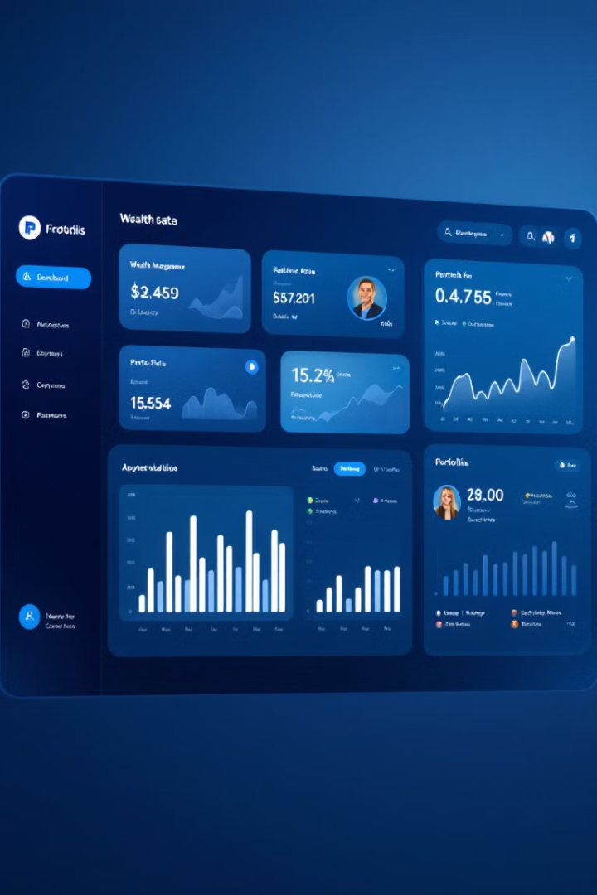



Wealth Management Platform
Our Financial Hub
Cloud-Native
Leveraging AWS for scalability and resilience
Enterprise Security
Military-grade protection for high-net-worth clients
Modern Stack
Built with Spring Boot, React, and GraphQL

Slide 3





Business Requirements
Driving Strategic Success
Scalable, Secure Development
High-quality production code with Spring, React, GraphQL
Architecture & Design
HLD, LLD, UI, data design, coding standards
Role-Based Features
Customized dashboards for clients, advisors, compliance
AI-Driven Insights
Real-time investment alerts with military-grade security

Slide 4

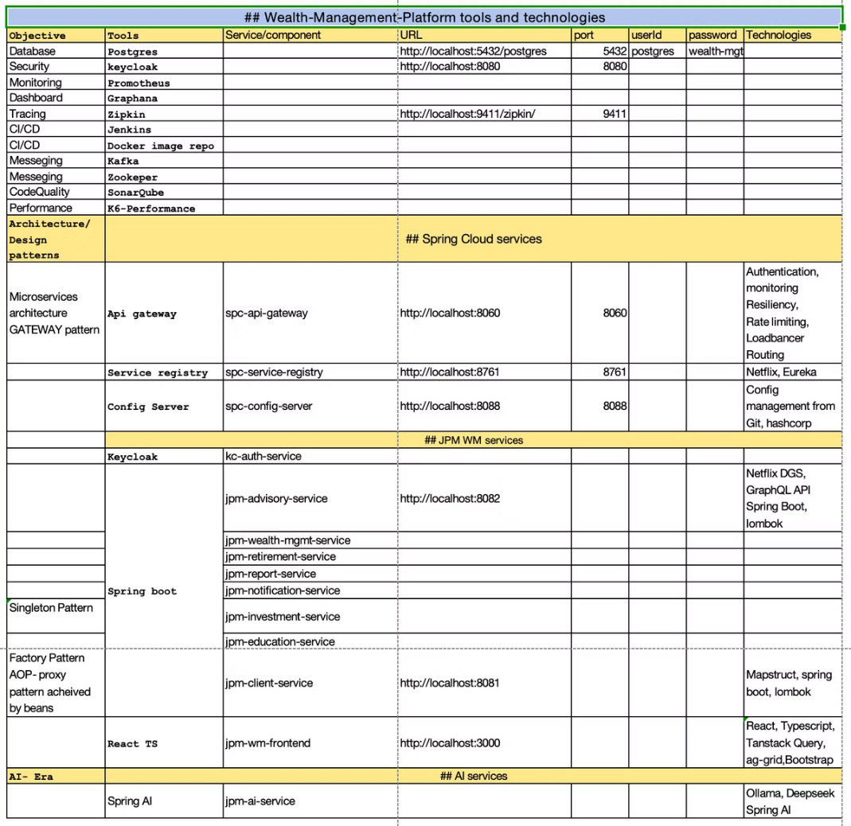
Development
Roadmap
Path to Innovation
1
Requirements
Gather client needs and regulatory constraints
2
Architecture
Define high/low level designs
3
Implementation
Develop UI, database, deployment
4
Testing
Validate security and scalability
5
Code scanning
From sonarQubes
6
Stress Testing
Define your standard benchmarks
7
Deployment
to cloud
8
Monitoring
Through Dashboards, Get alerts

Slide 5
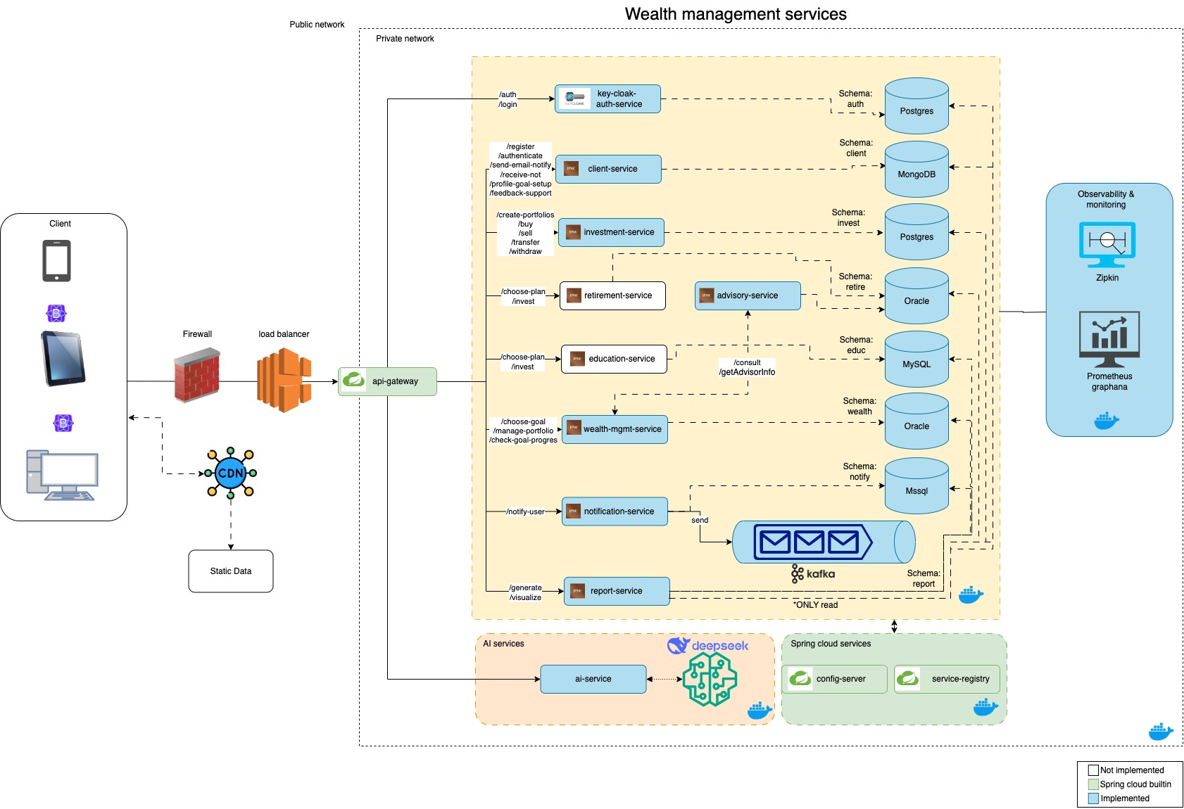
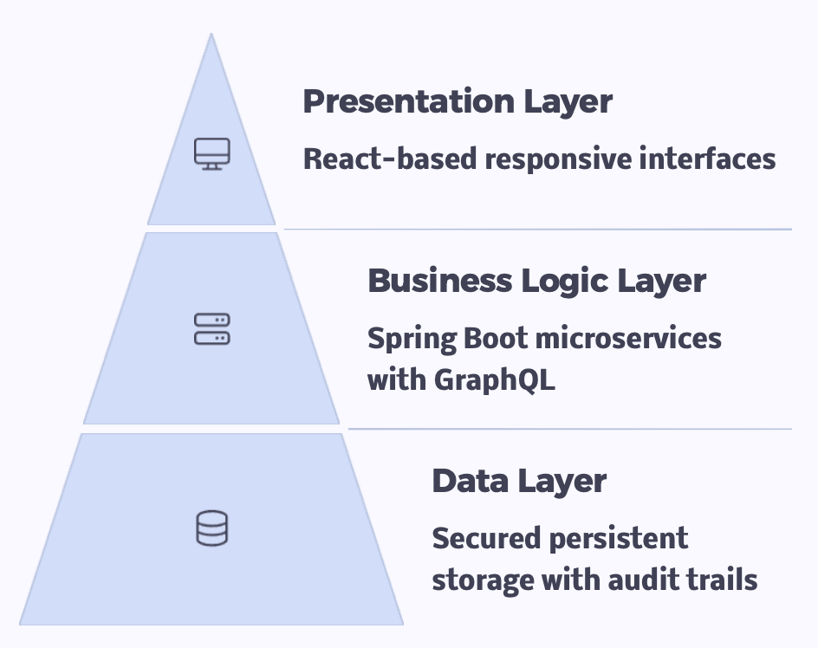
Three Tier Architecture
Robust and Scalable Design

Slide 6

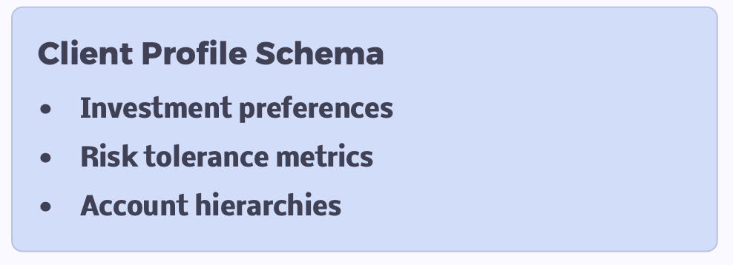
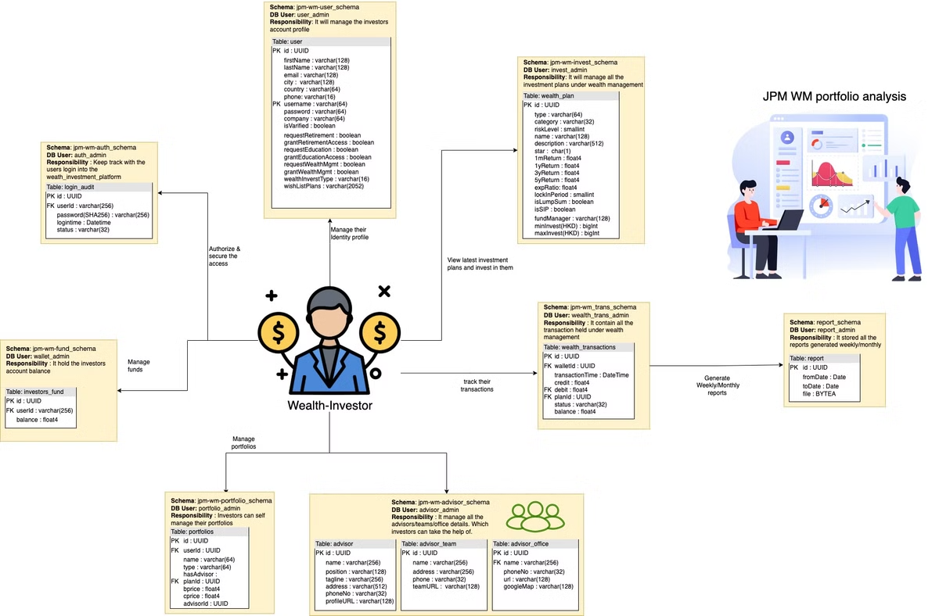
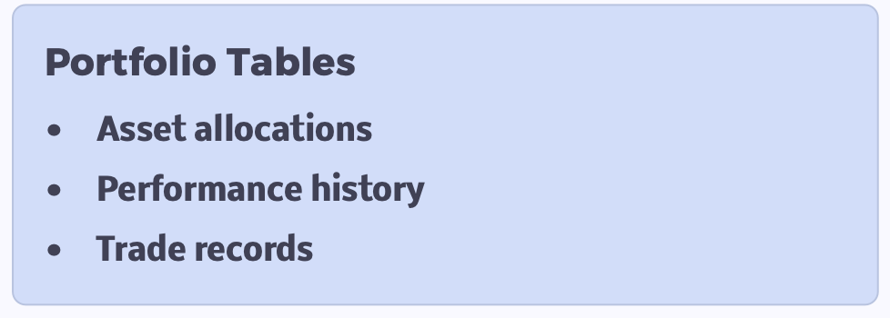
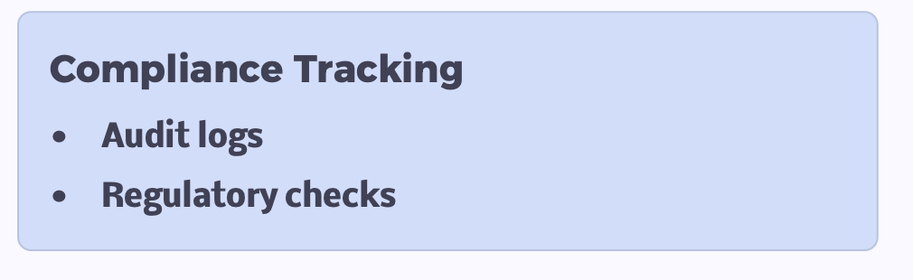
Database Design
Structured for Efficiency

Slide 7
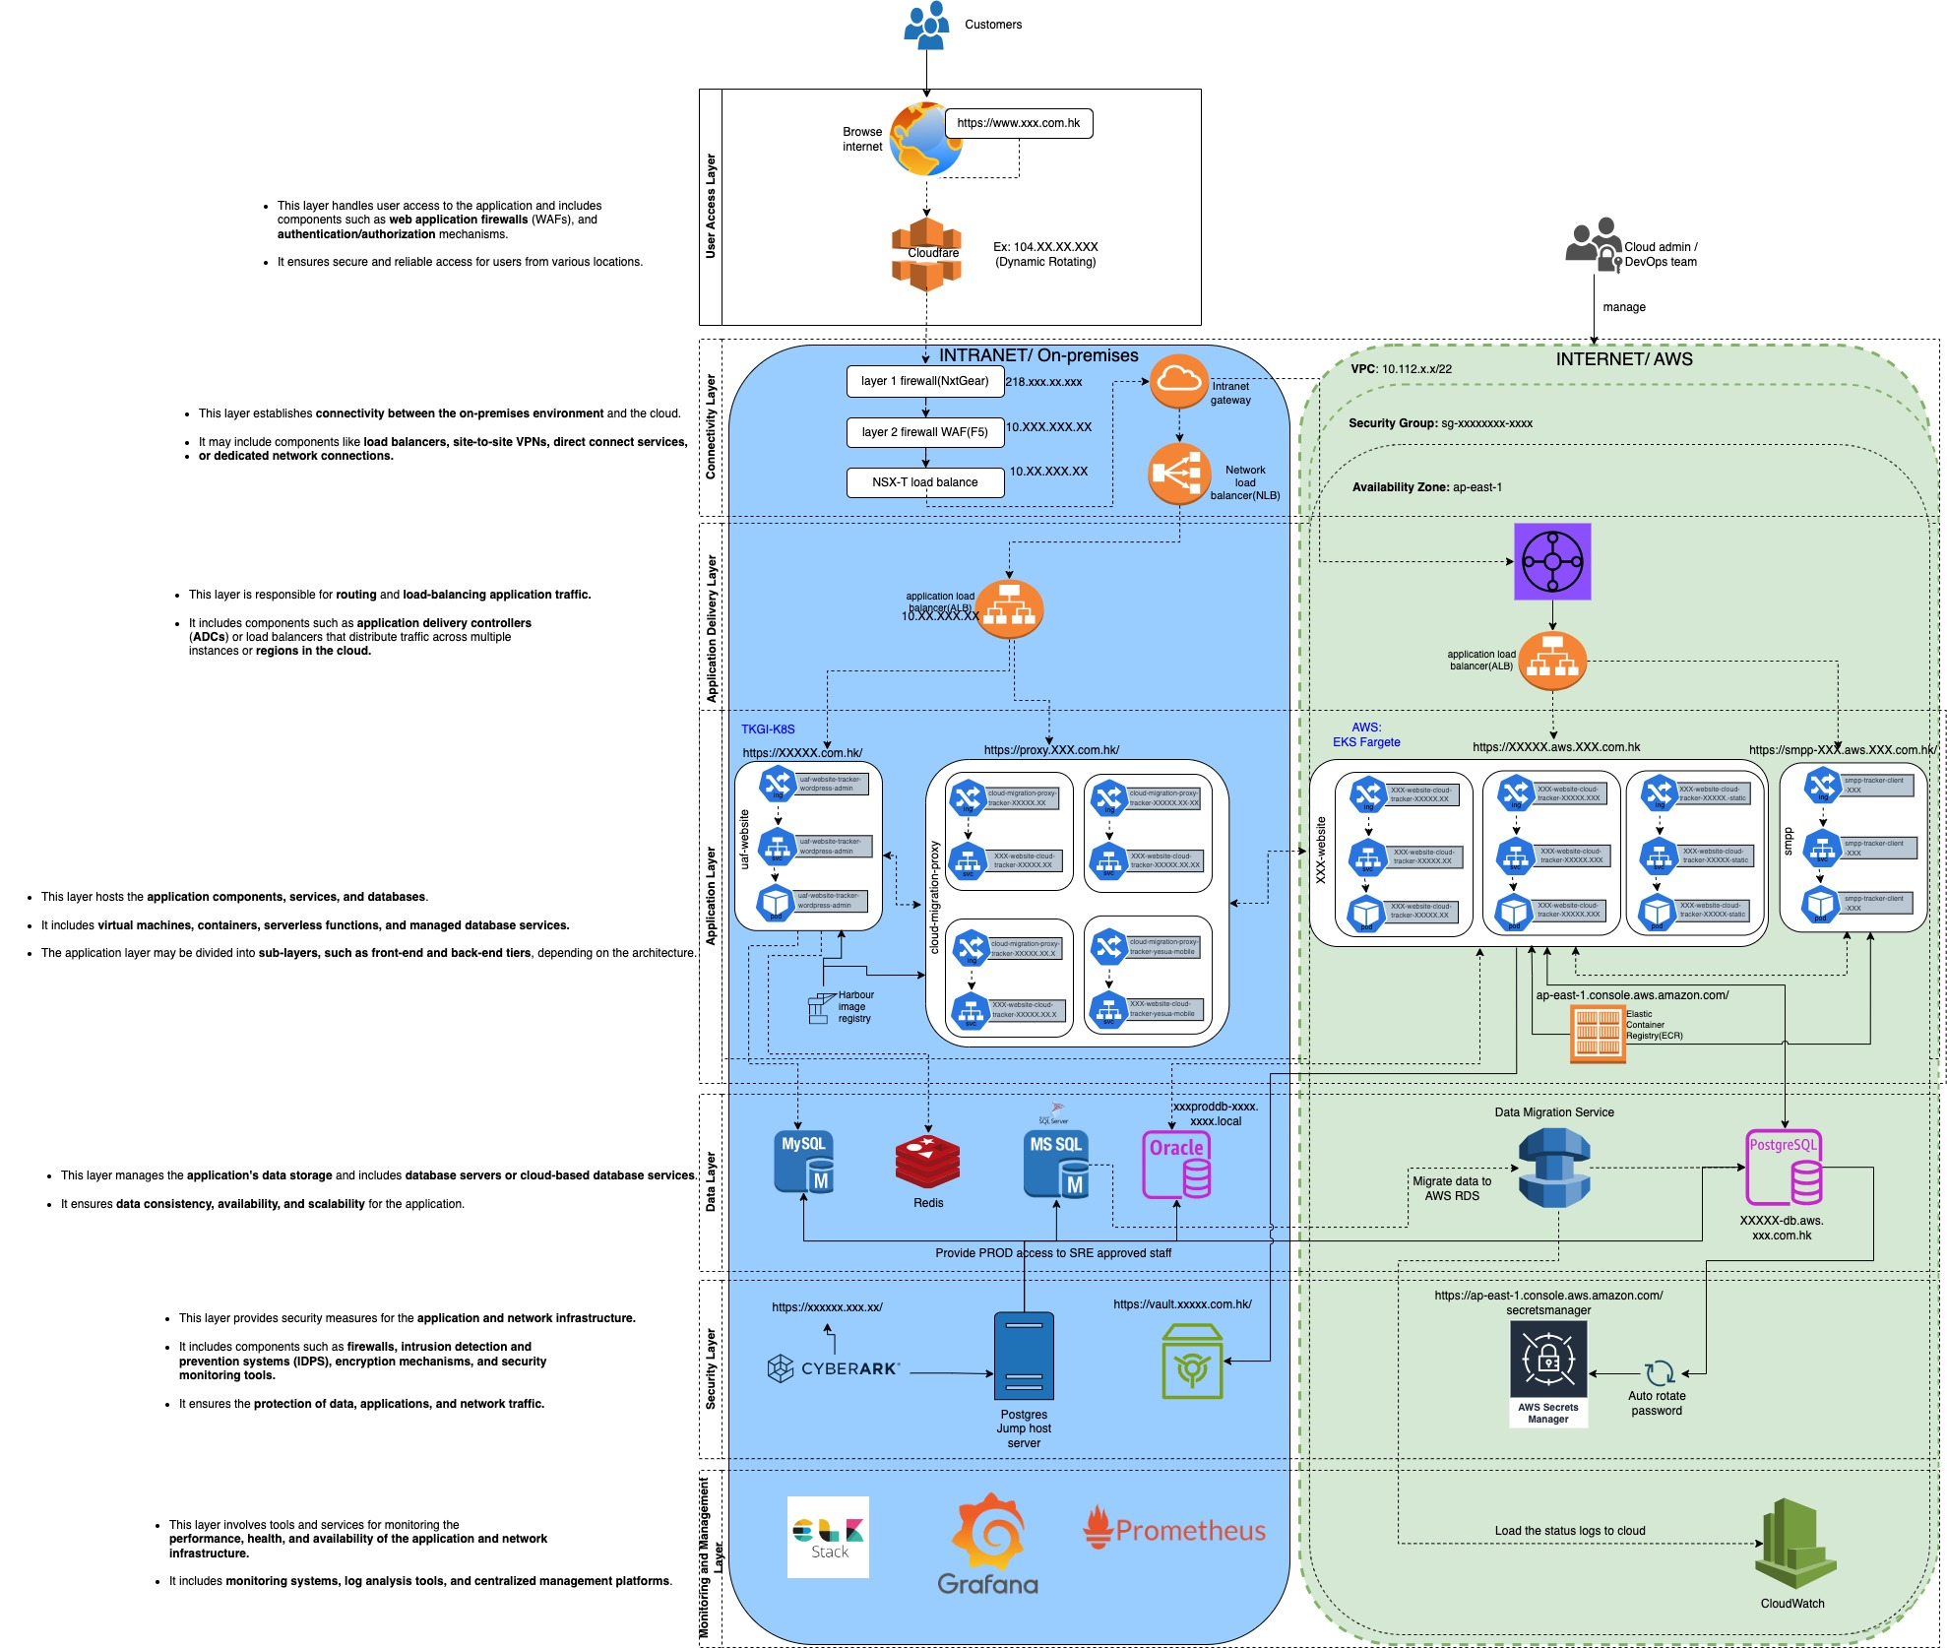
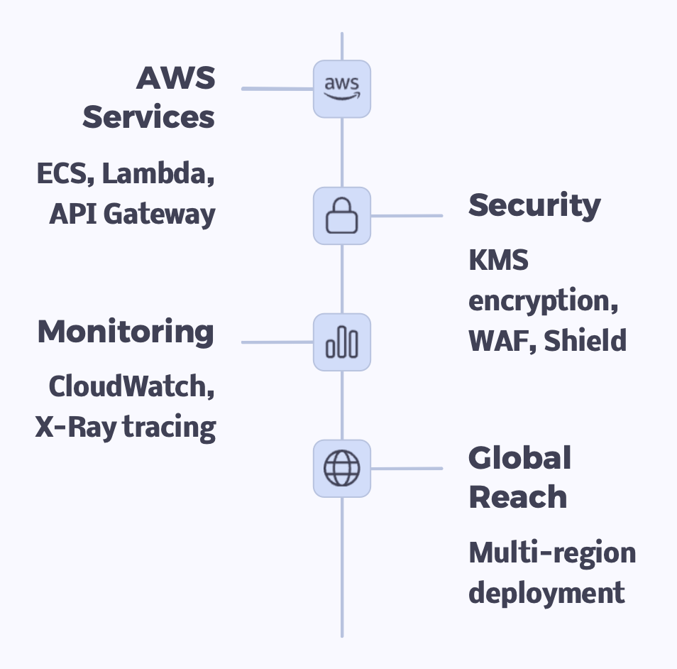
with 7 network layers
Cloud
Infrastructure
Secure and Resilient Connectivity

Slide 8
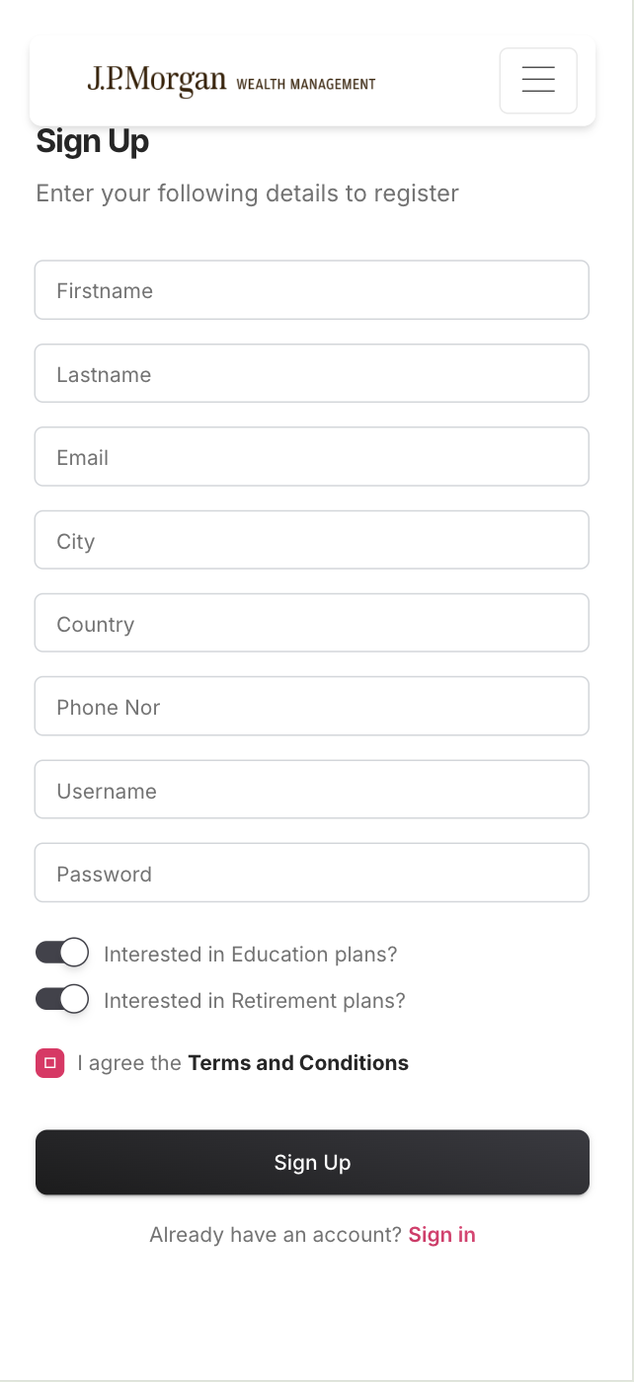
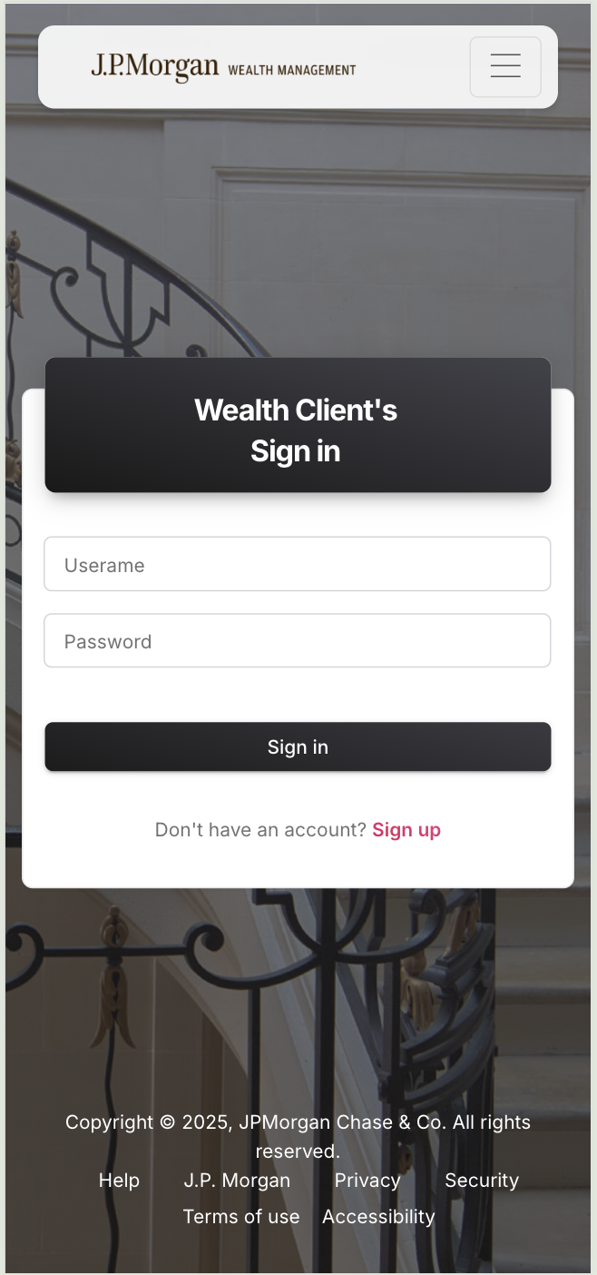
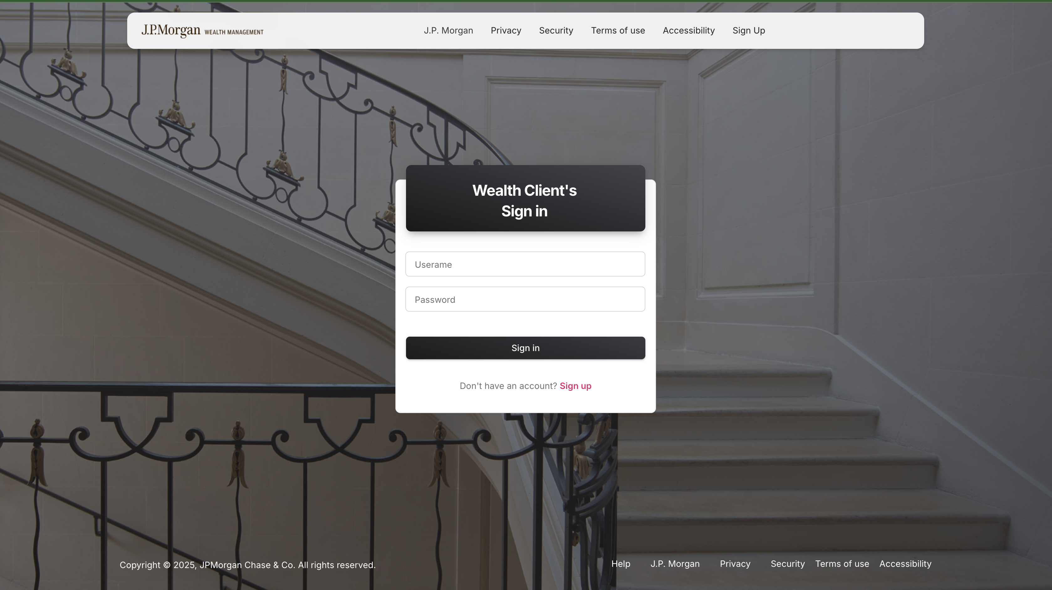
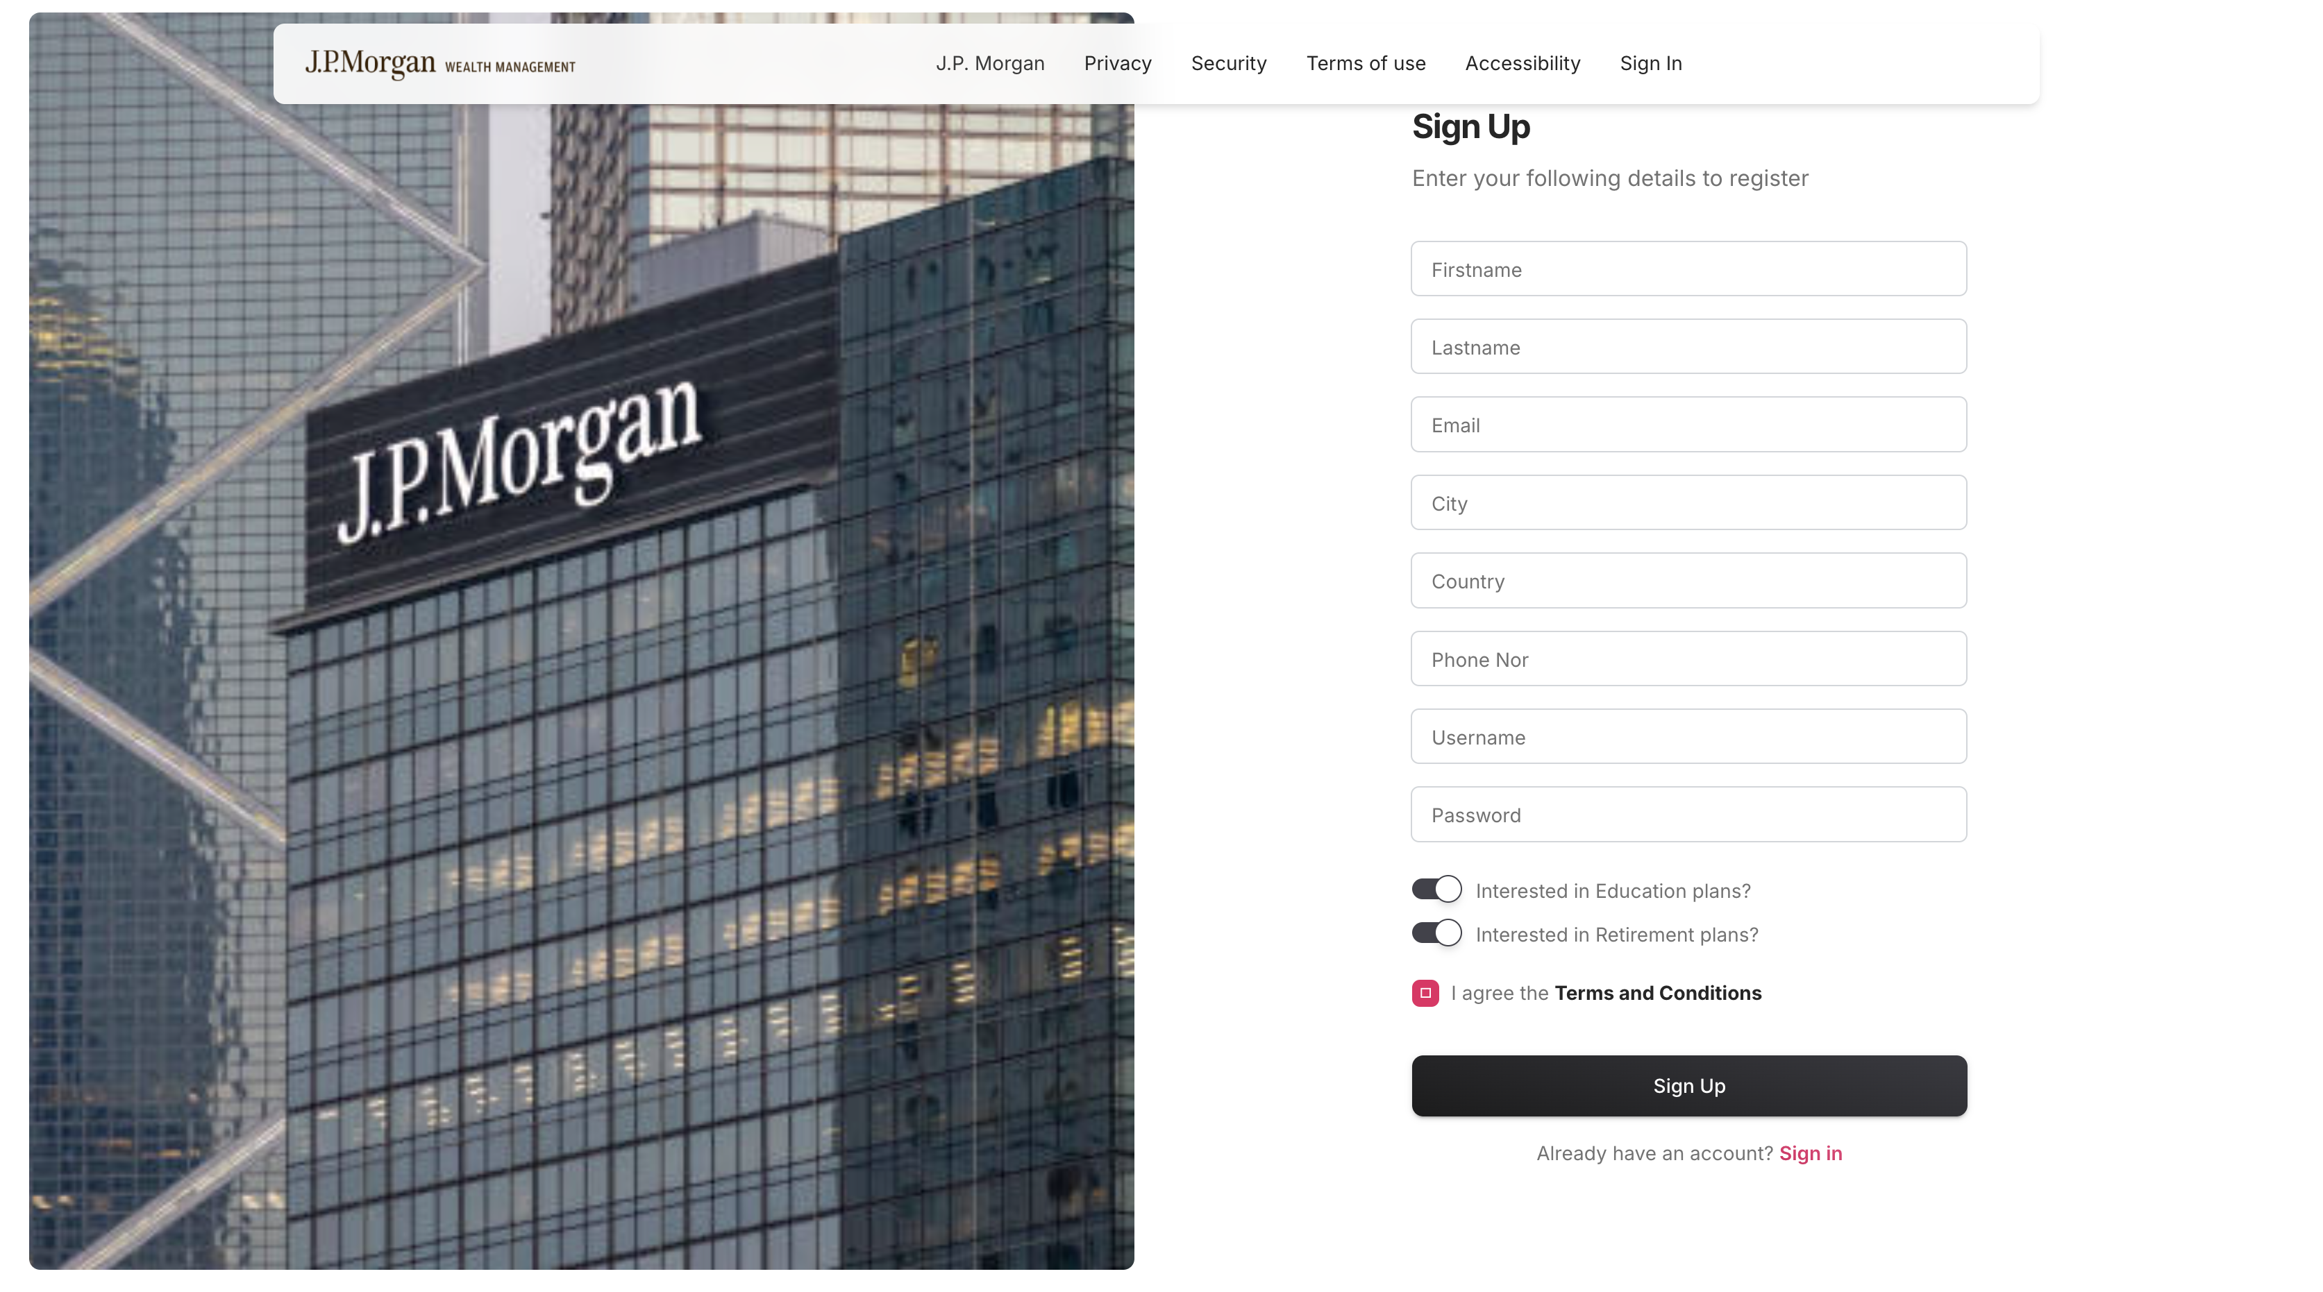
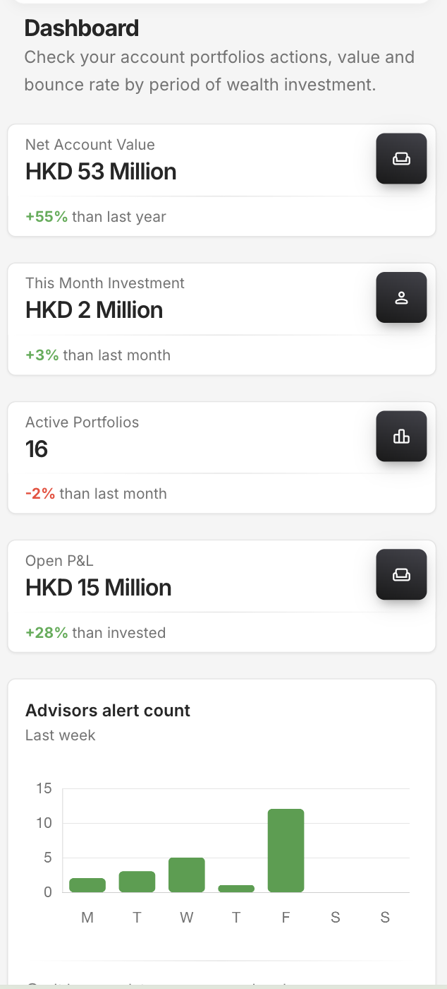
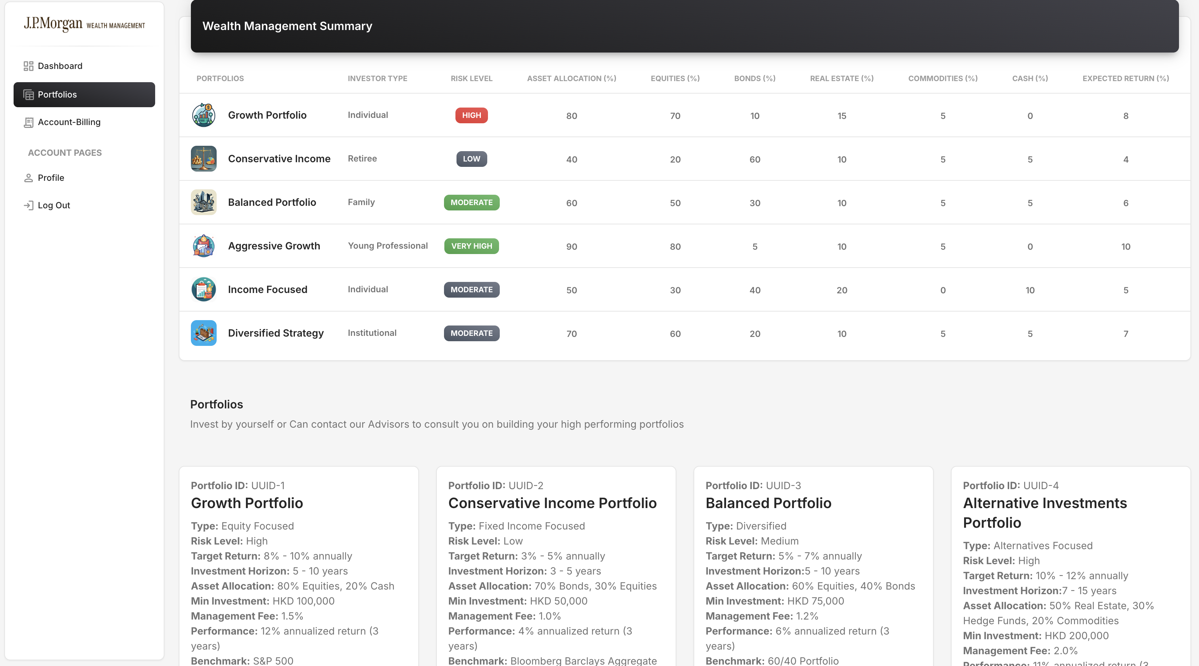
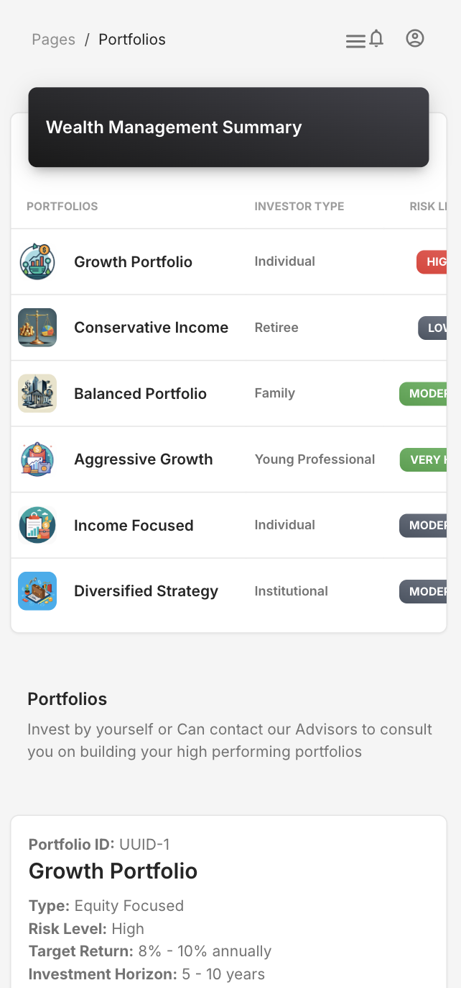
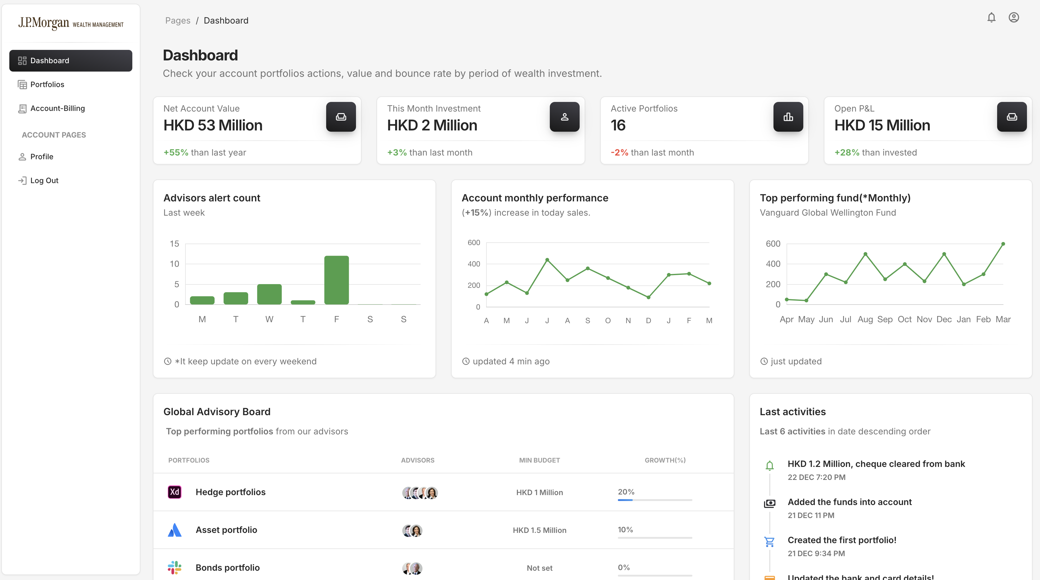
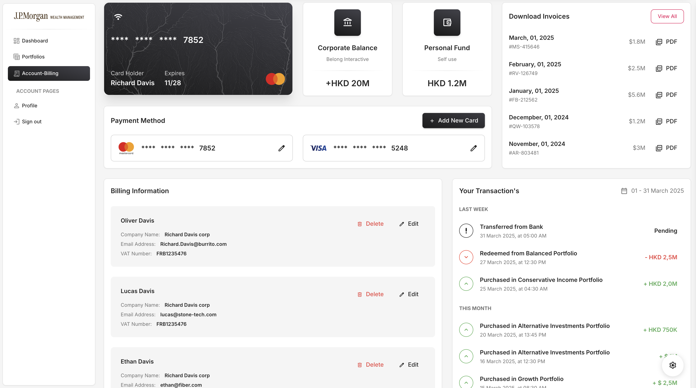
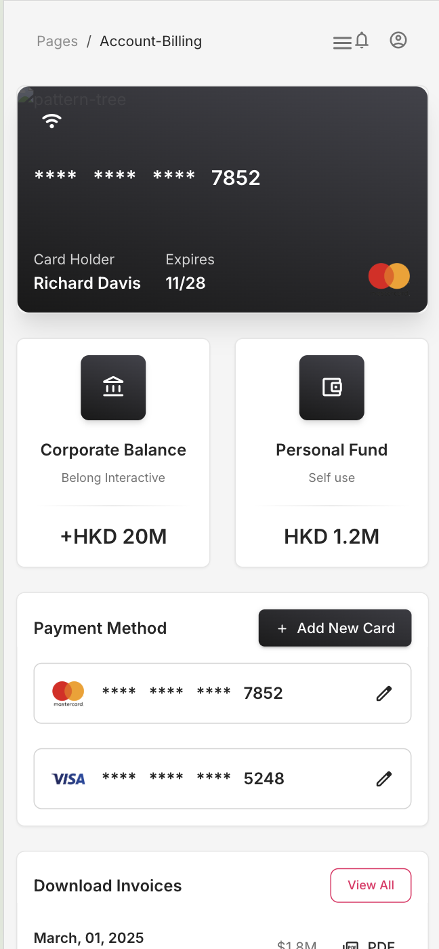
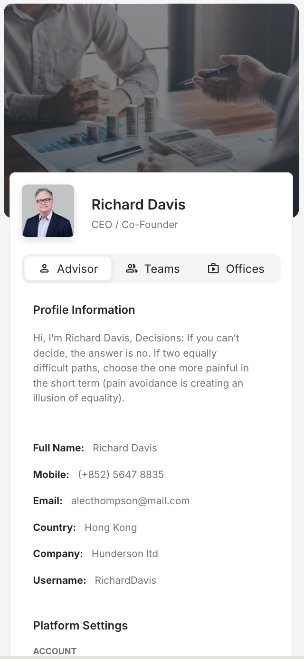
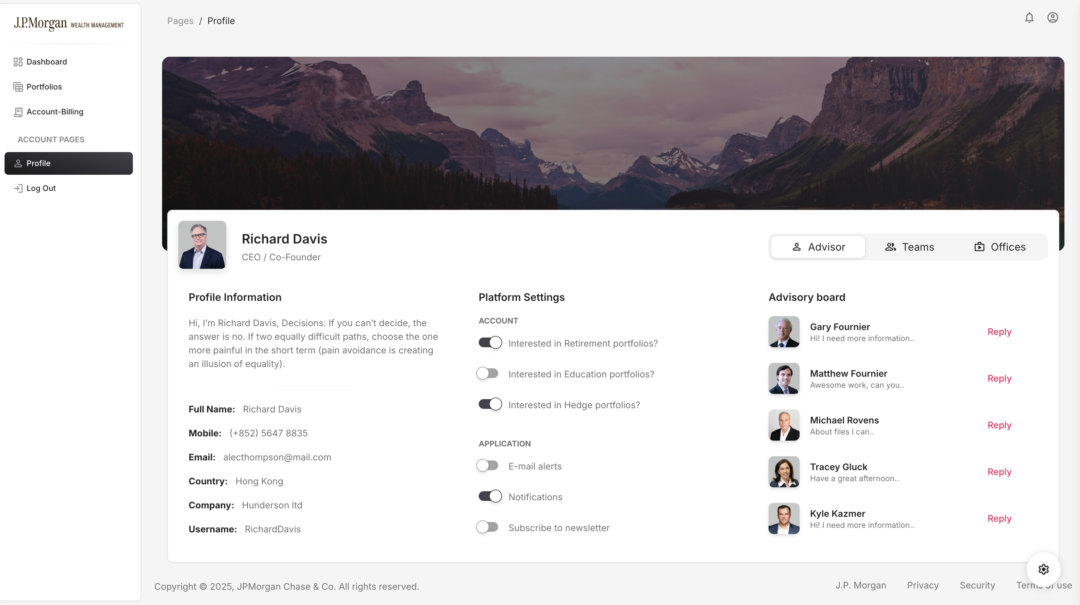
Demo Screens
Seamless User Experience
Desktop & Mobile
1
2
3
4
5
6
Platform interfaces for client register, login, dashboard, portfolio analysis, billing-payment and profile settings.

Slide 9
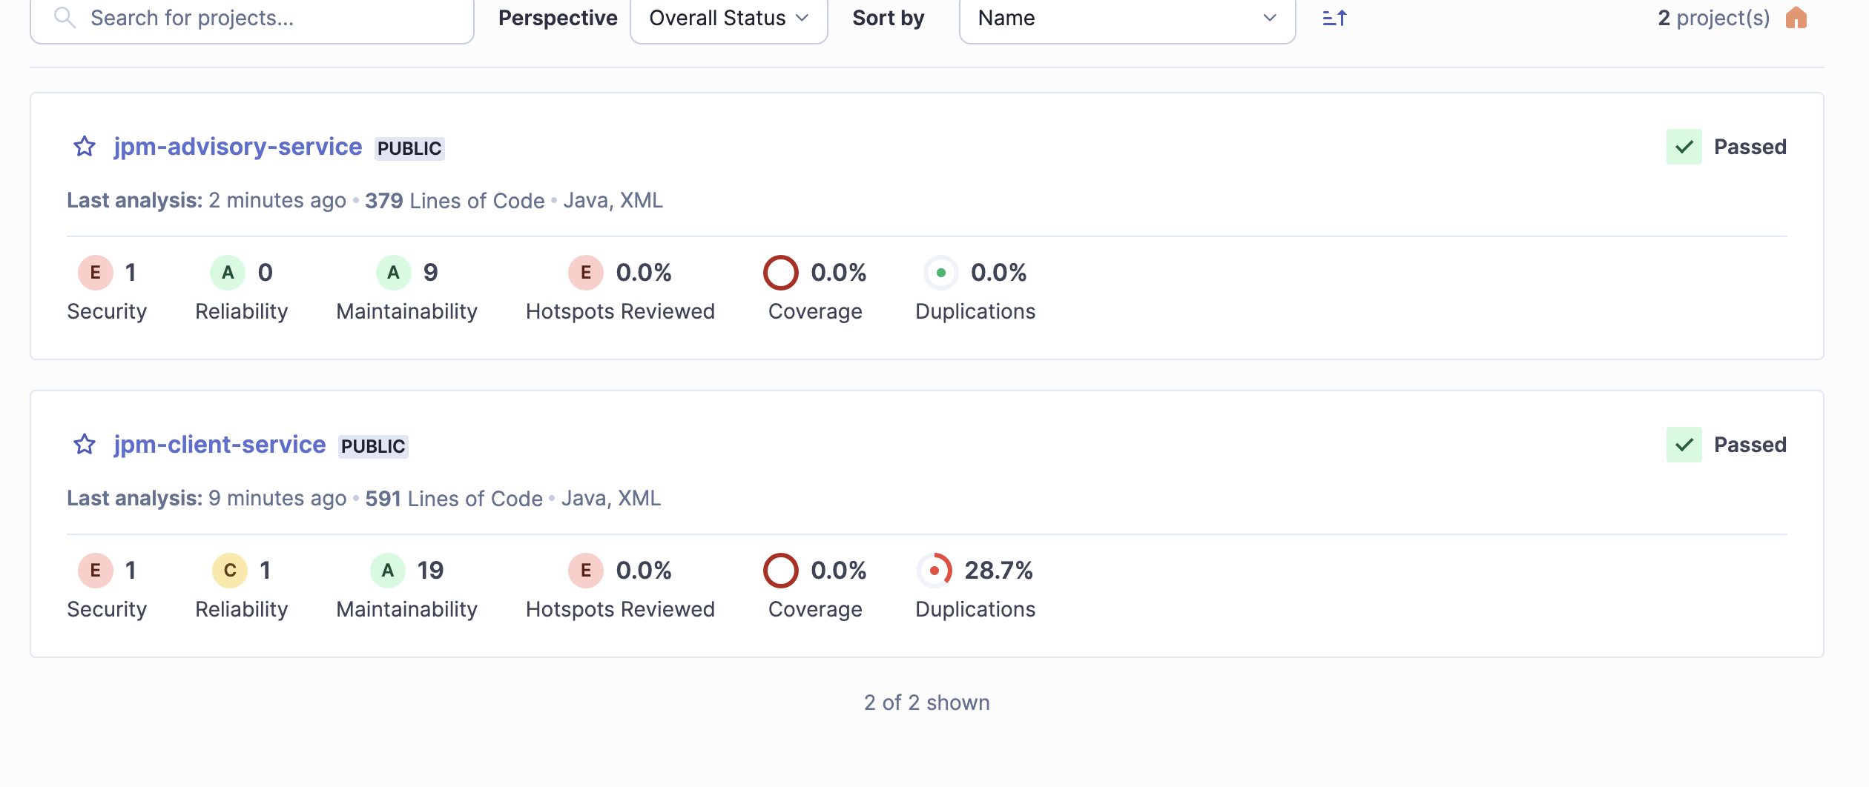
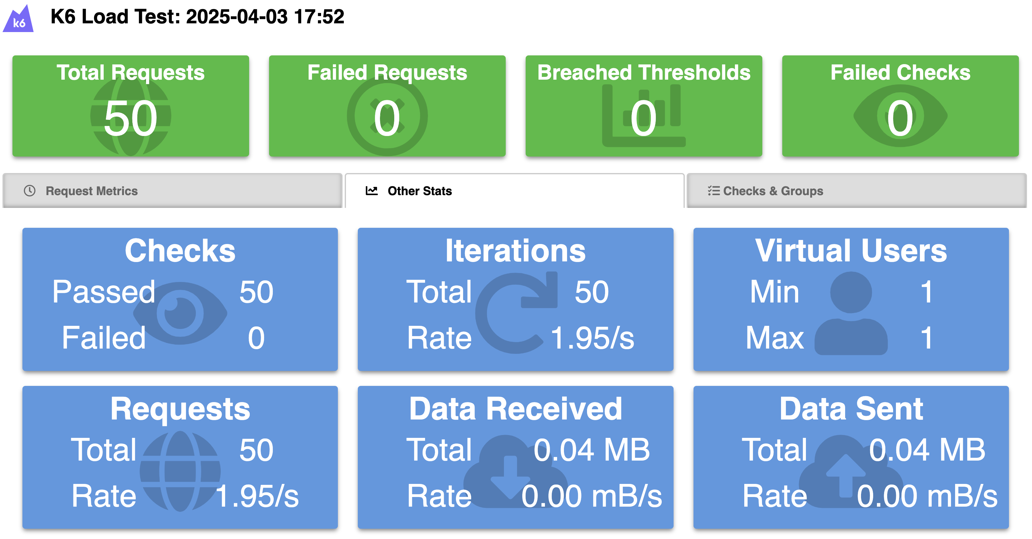
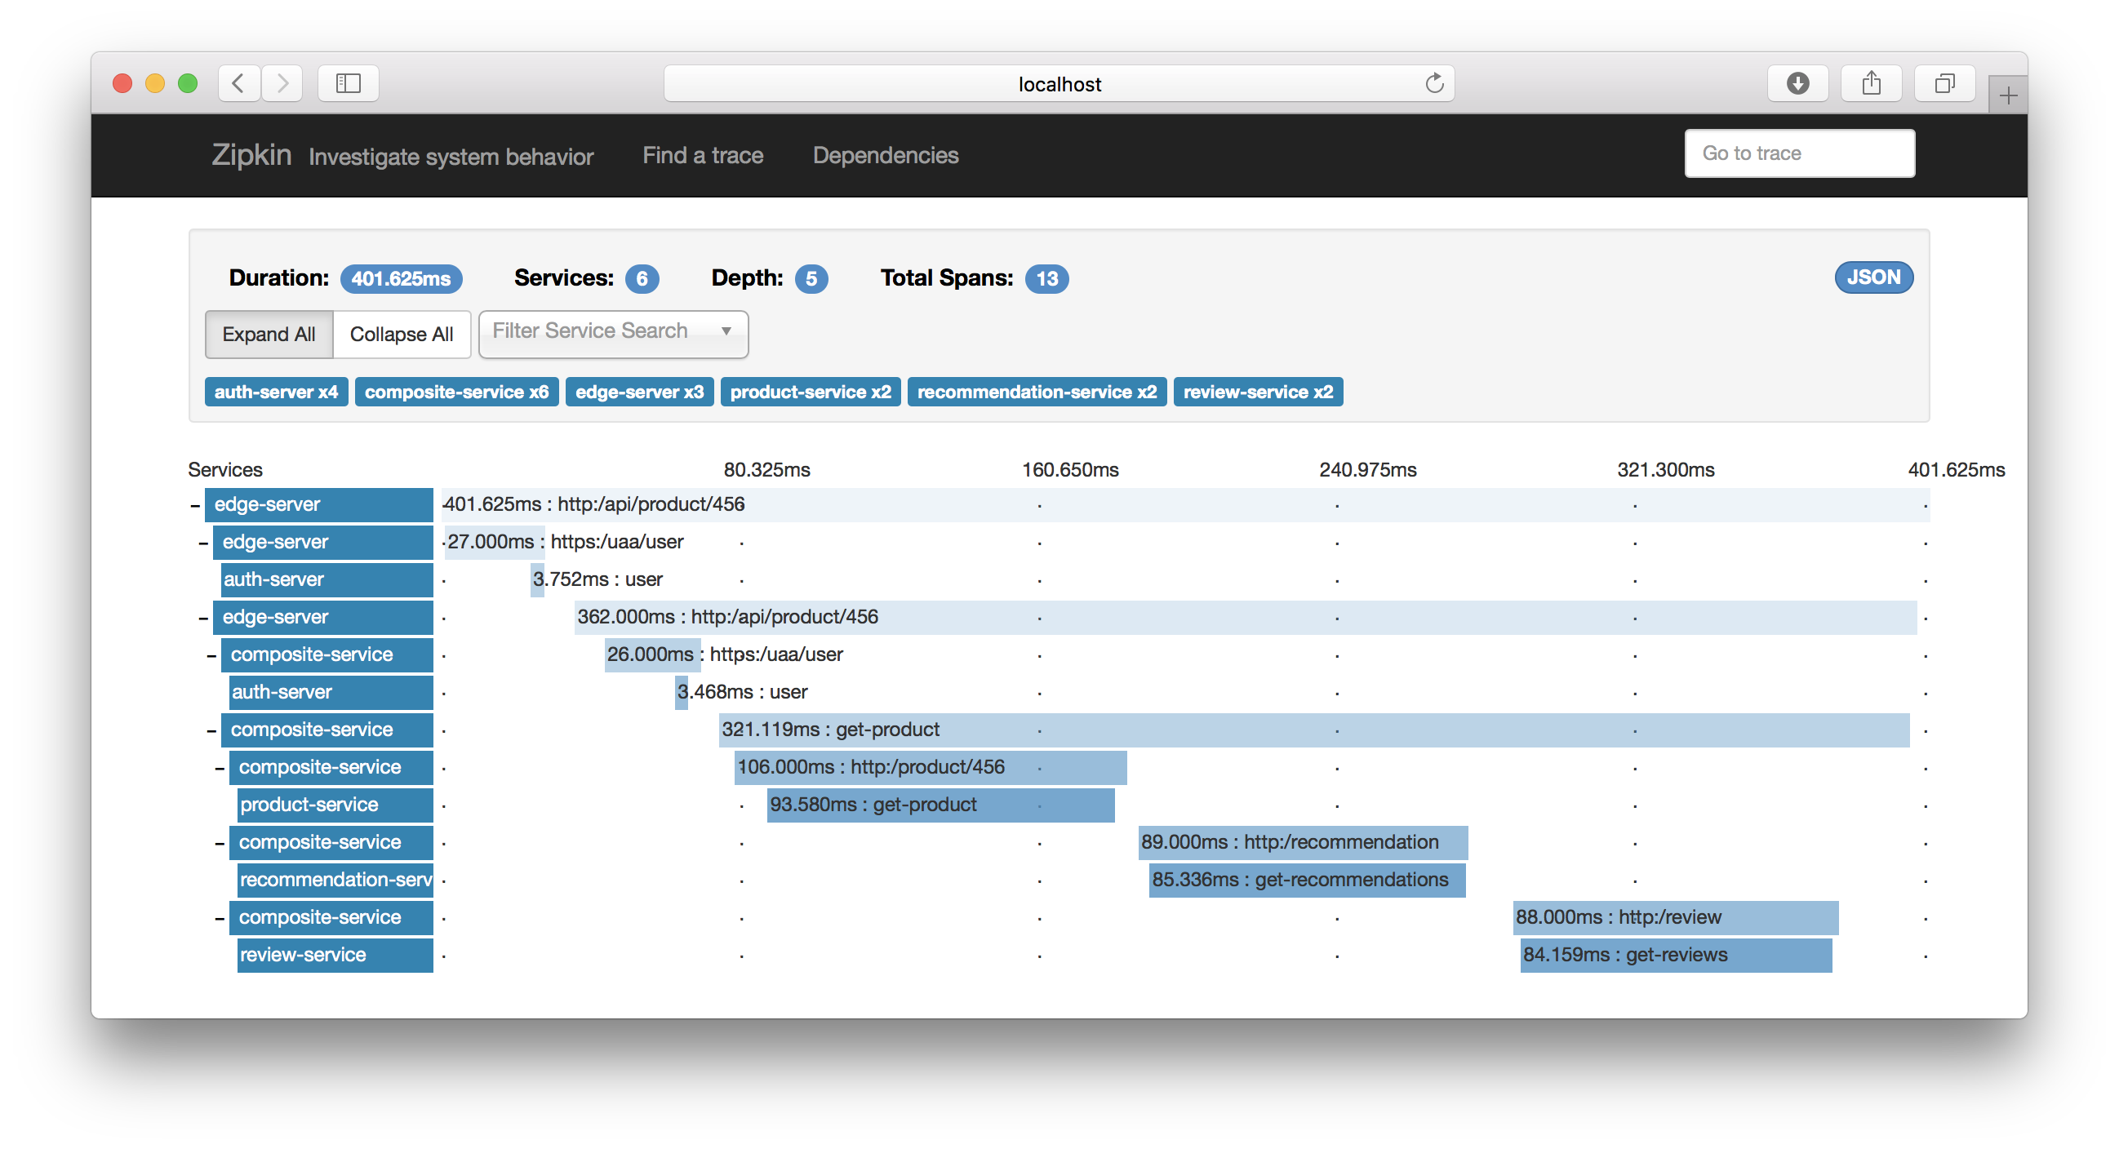
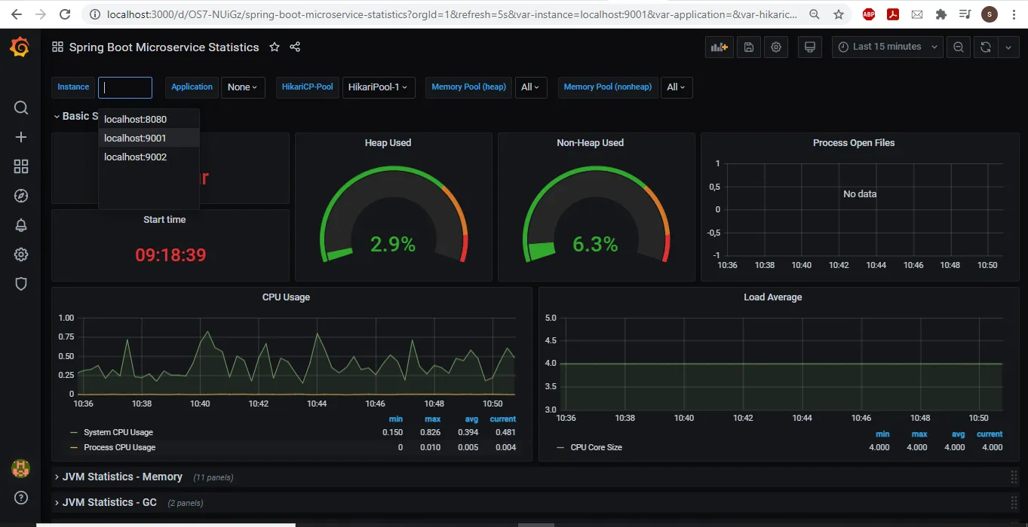
Performance Reports
Insights for Informed Decisions
SonarQube test reports | API Load test Performance
Zipkin services log tracing | Graphana dashboard

Slide 10



Why ONLY me?
Your Trusted Lead Software Engineer
Mentorship from Master Shifu
Performing With Team
Being individual

Slide 11
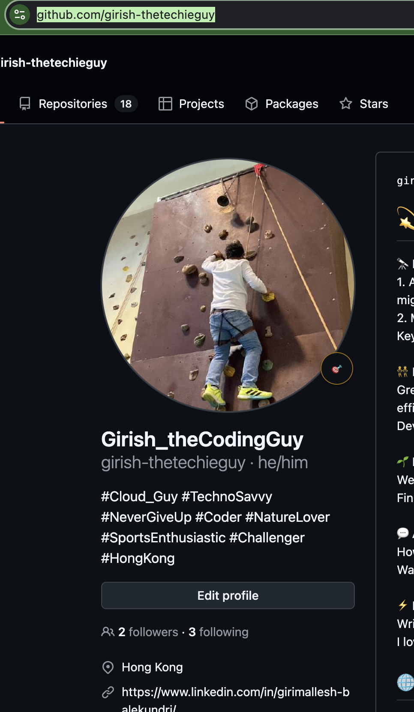
References
How can track me?
https://github.com/girish-thetechieguy
Wealth management platform : https://github.com/girish-thetechieguy/wealth-management-platform
React POC projects : https://github.com/girish-thetechieguy/React-POC-projects
UI design: https://github.com/girish-thetechieguy/wealth-management-platform/tree/main/jpw-wm-ui-design
Backend : https://github.com/girish-thetechieguy/springboot-microservices
https://github.com/girish-thetechieguy/saga-orchestration-event-driven-microservices
This presentation: https://github.com/girish-thetechieguy/wealth-management-platform/blob/main/jpm-wm-project-execution/2_Design/Next-Gen-Wealth-Management.pptx

